Slide 1

Introduction to Natural Language Processing
Presented by:
Elizer Ponio Jr.
Department of Computer Science
College of Computing and Information Technologies

Slide 2
Outline
What is Natural Language Processing?
Why NLP is important
Tokenization
Word Sequence
Padding and Truncating
Tokenization of Large Datasets

Slide 3
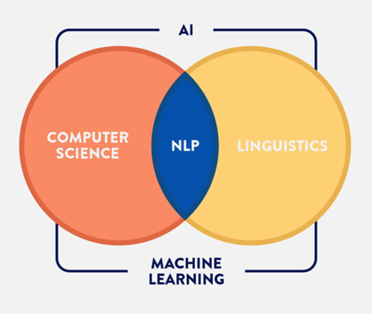
What is Natural Language Processing?
Natural Language Processing, or NLP for short, focuses on analyzing text and speech data.
This can range from:
Simple recognition (what words are in the given text/speech)
Sentiment analysis (was a review positive or negative)
Text generation (Writing a song or lyrics from scratch).

Slide 4
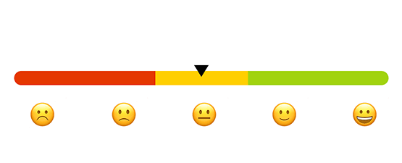
Why NLP is important
Sentiment Analysis

Slide 5
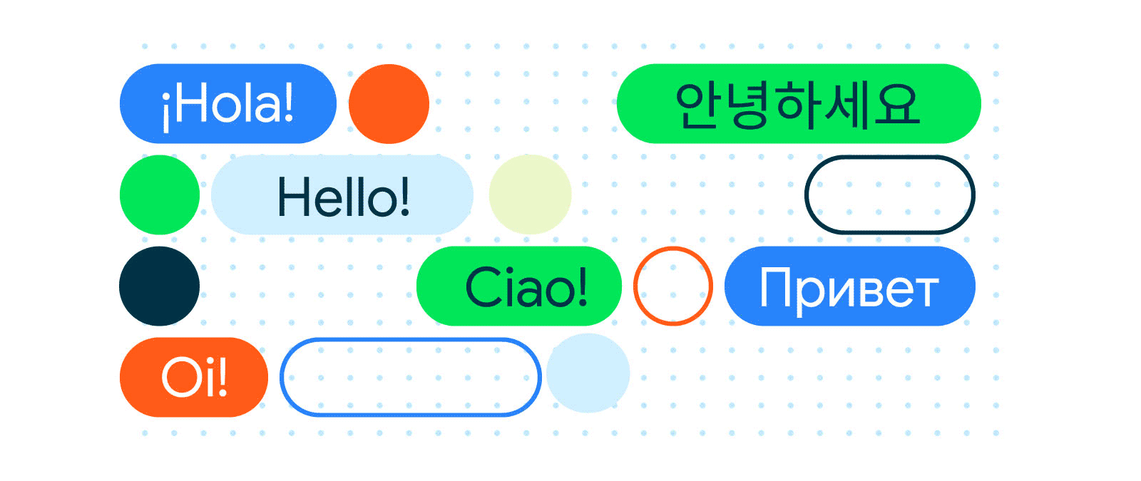
Why NLP is important
Machine Translation

Slide 6

Why NLP is important
Voice Assistant

Slide 7
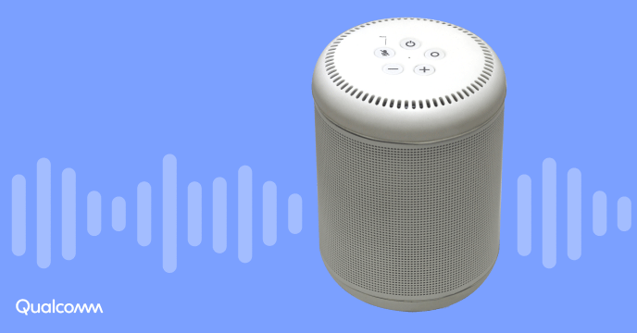
Why NLP is important
Smart Speaker

Slide 8
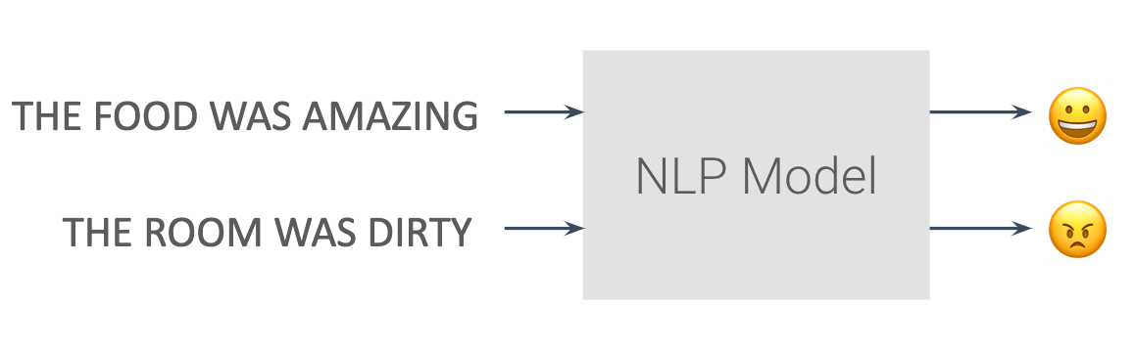
Sentiment Example

Slide 9
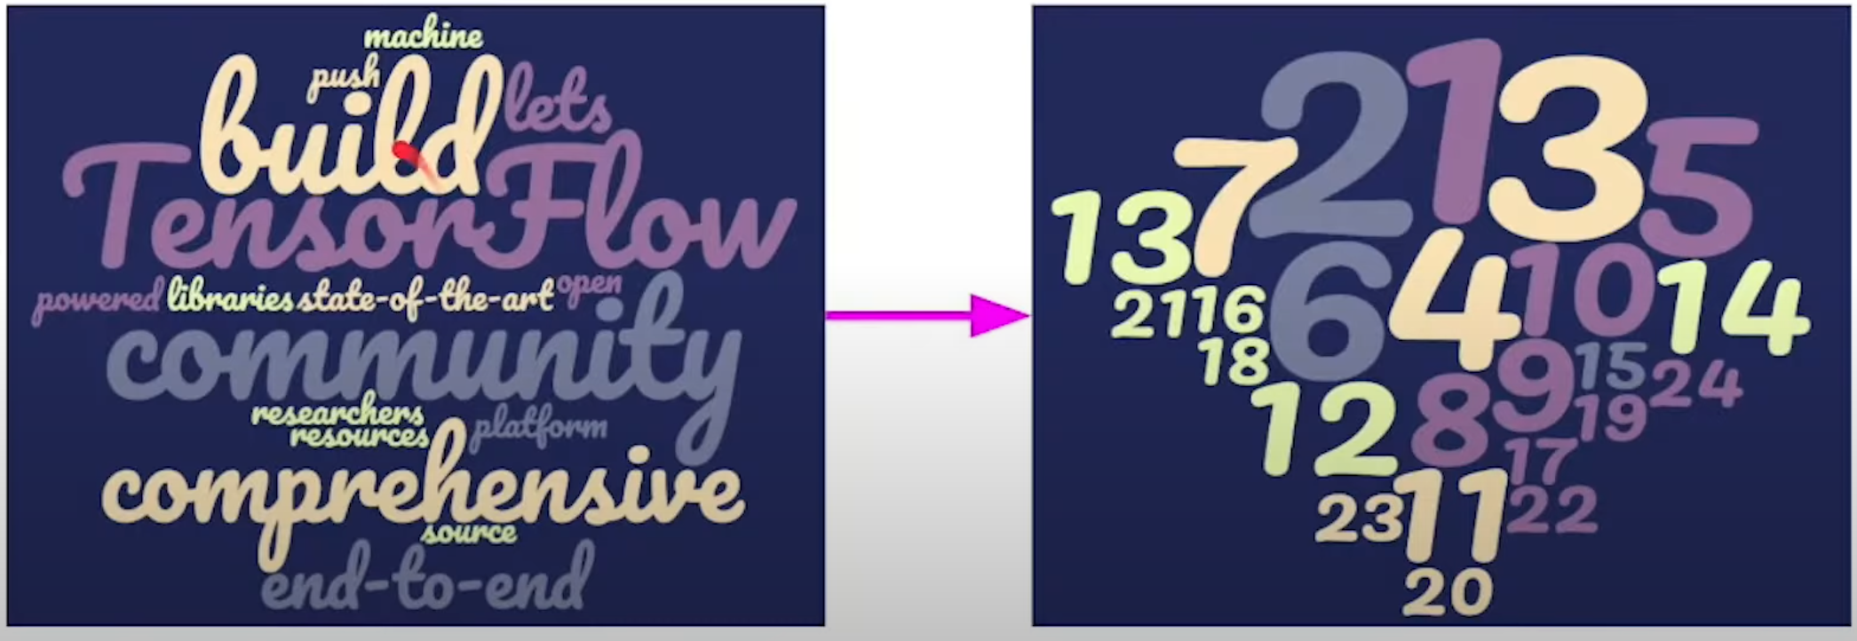
Tokenizing Text
Neural networks utilize numbers as their inputs, so we need to convert our input text into numbers.
Tokenization is the process of assigning numbers to our inputs.

Slide 10
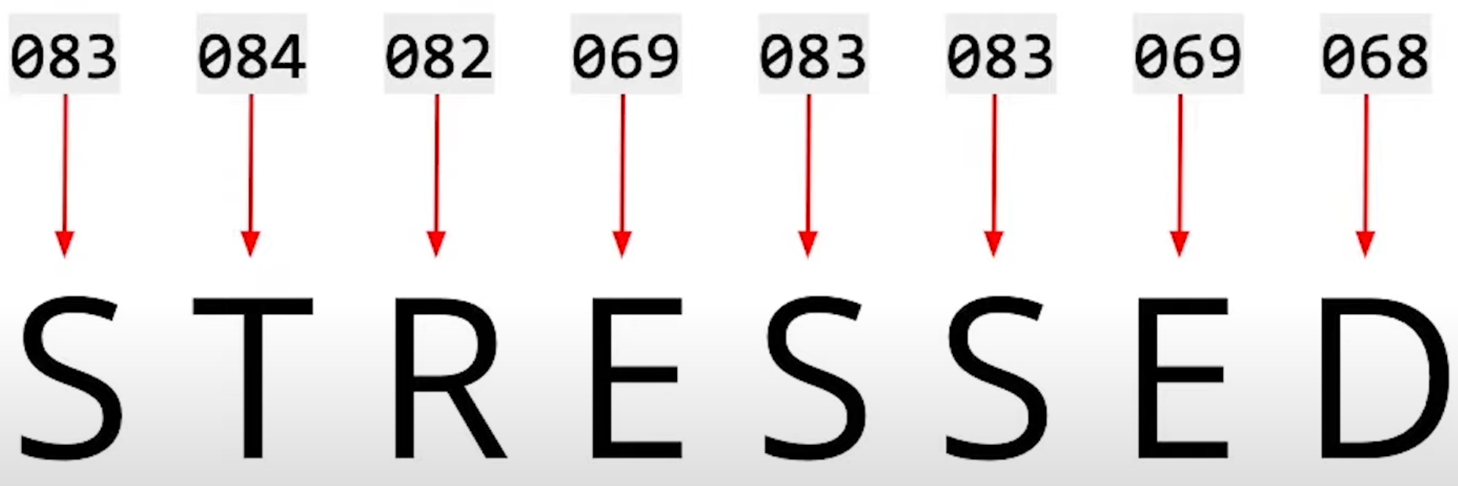
Turning Text into Numbers

Slide 11
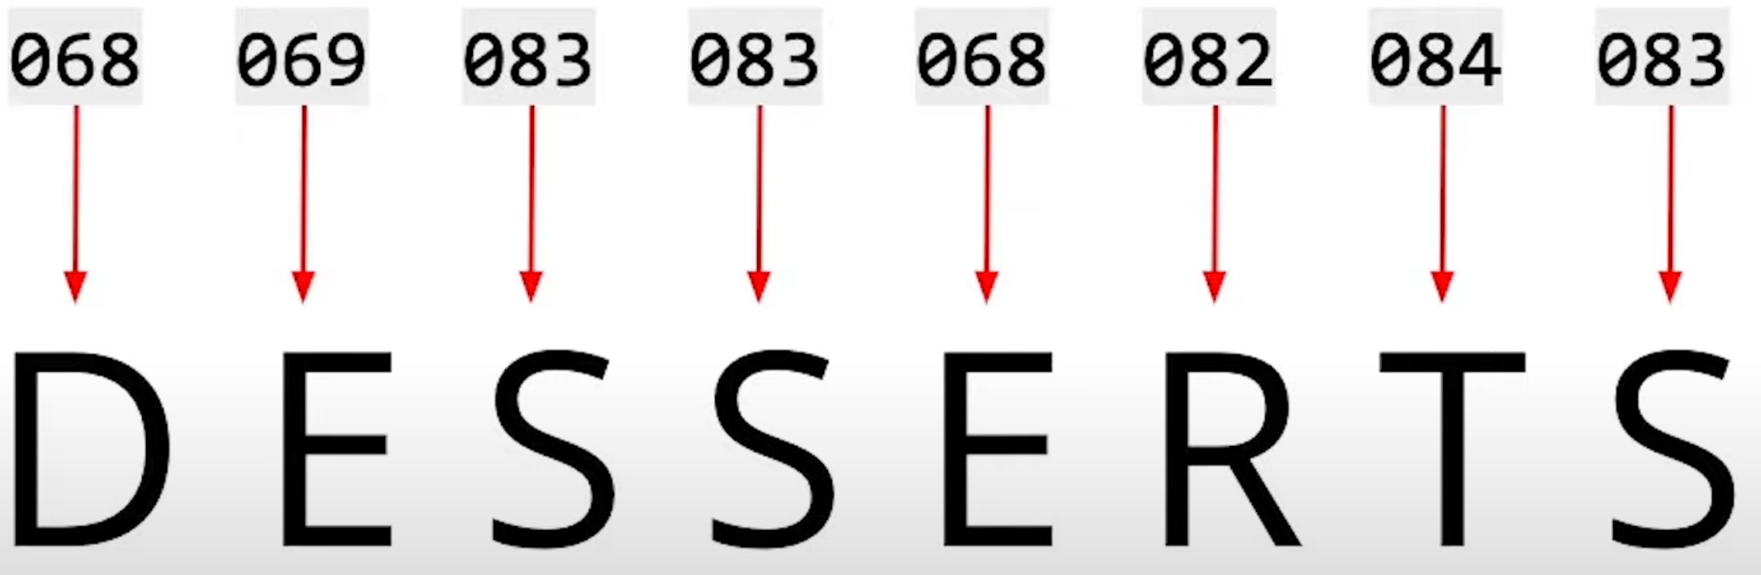
Turning Text into Numbers

Slide 12
Turning Text into Numbers
For an anagram like stressed and desserts, neural networks sees these two words as the same input. Thus, we cannot assign each number a letter.

Slide 13
Turning Text into Numbers
For natural language processing, we want to process the meaning and sentiment of the words which requires looking at the words not just the letters that make up the words.

Slide 14
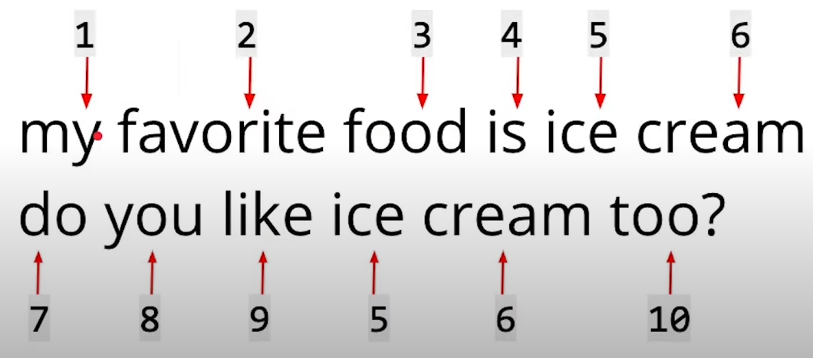
Turning Words into Numbers
We can represent whole words as numbers.
In this example, the second sentence also has the words “ice” and “cream” and these words have the same numerical value in the first and second sentence.

Slide 15
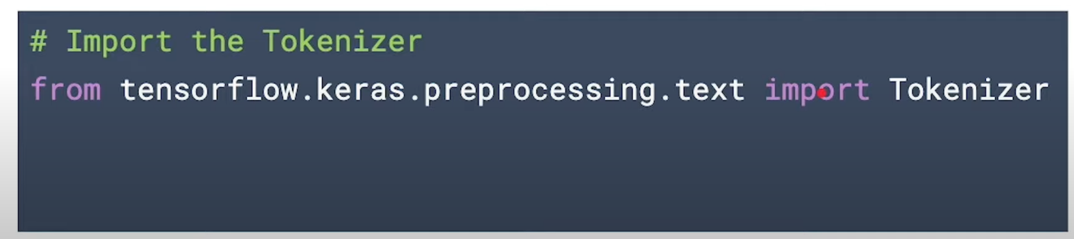
Tokening text
Use Tokenizer to tokenize text (to get a number for each word)

Slide 16
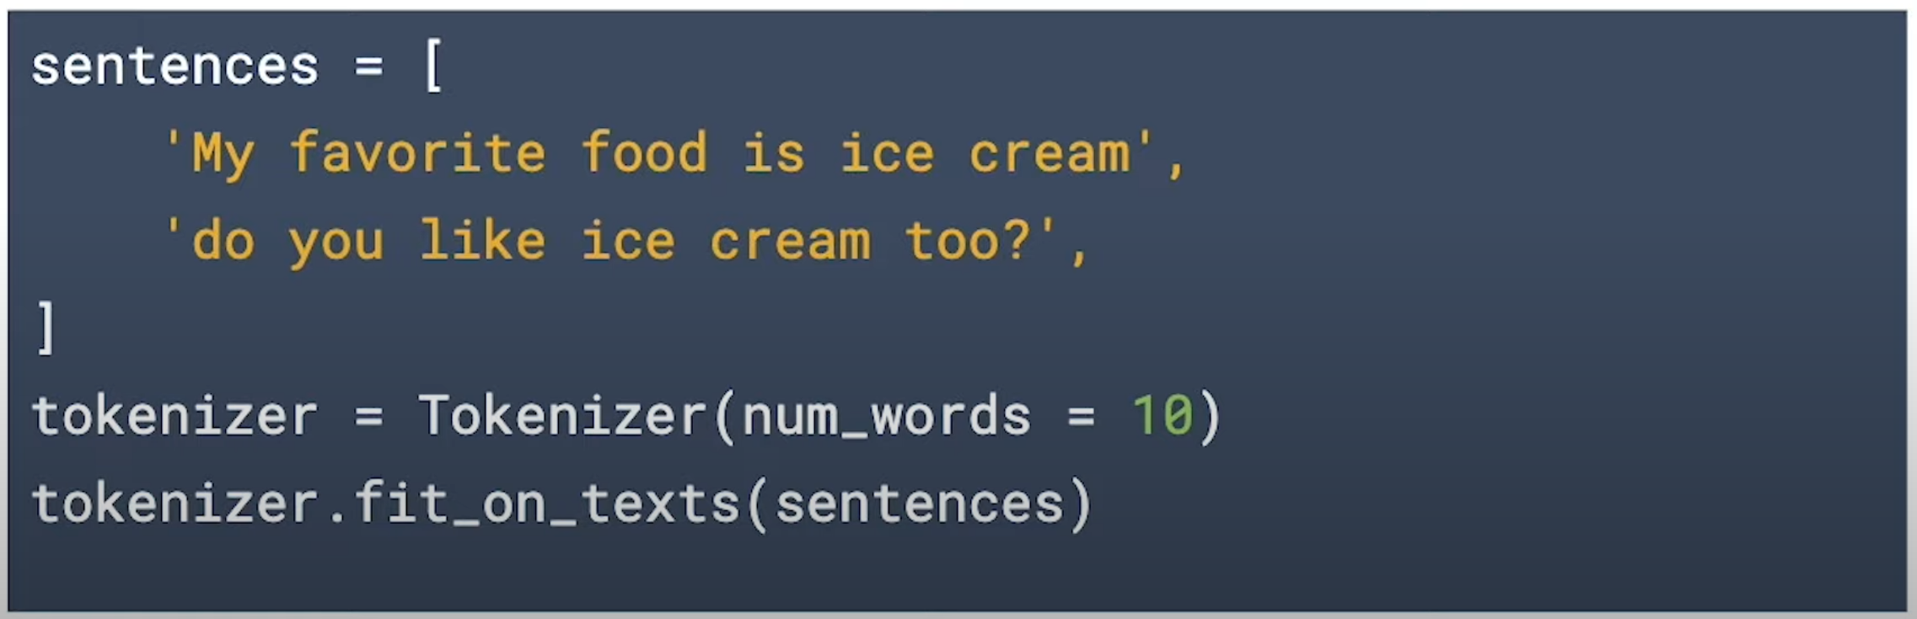
Tokening text
Use fit_on_texts() to turn words into tokens to get the word index

Slide 17
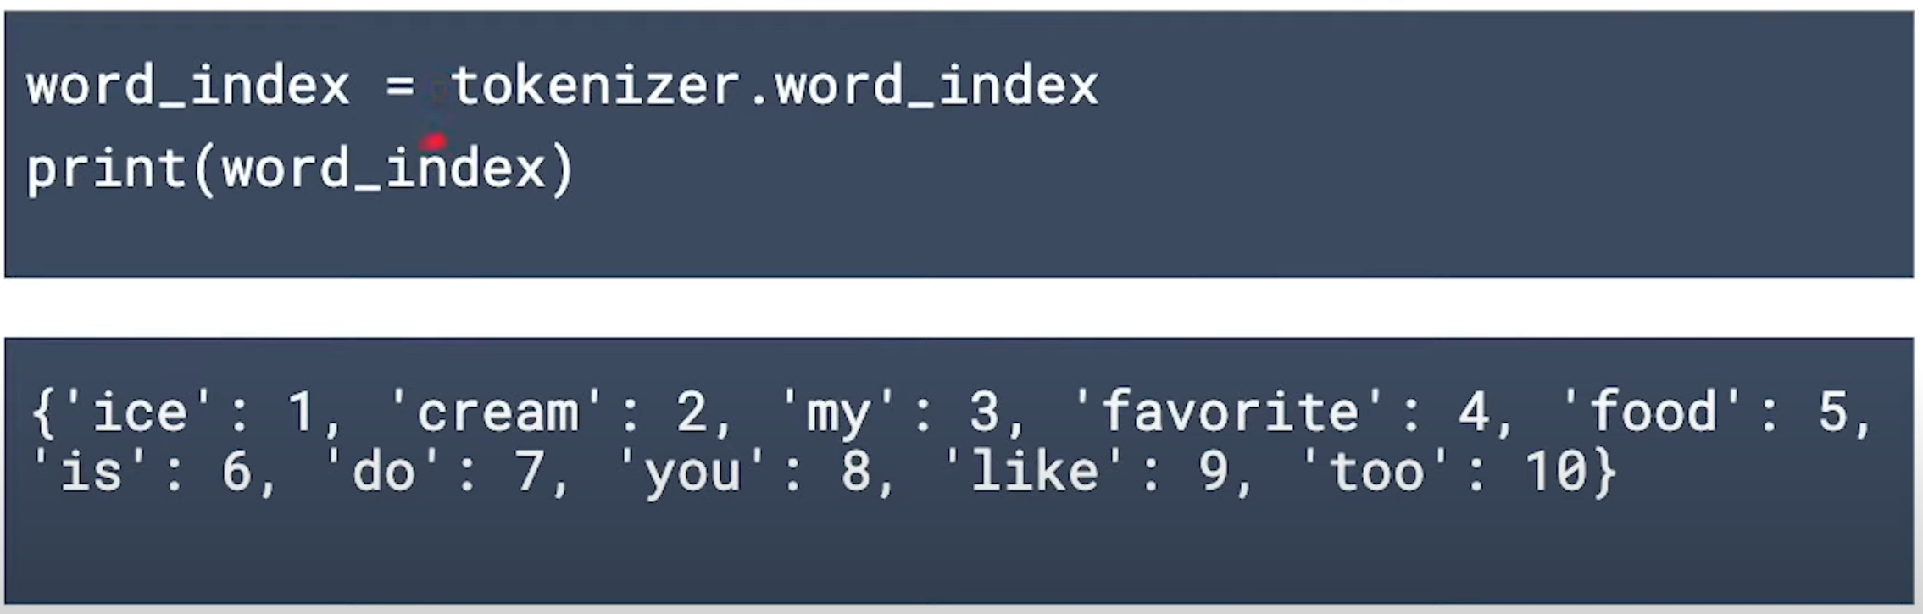
Word Index
Use .word_index to return the word index

Slide 18
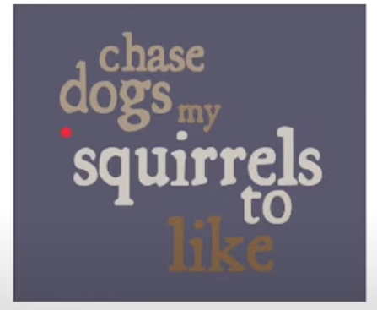
Word Sequence Matters
As we have seen, just assigning numbers to letters is not enough.
Similarly, It is also not enough to assign numerical values to words. Word Sequence matters!
Throwing words together in any old sequence can result in nonsense:
Chase dogs my squirrels to like
Dogs squirrels like my chase to

Slide 19
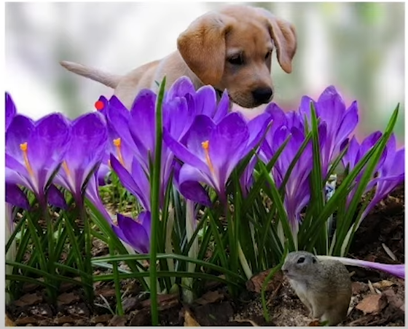
Word Sequence Matters
Even sentences that make sense grammatically do not always make sense
in a typical context.
My dogs like to chase squirrels
My squirrels like to chase dogs

Slide 20
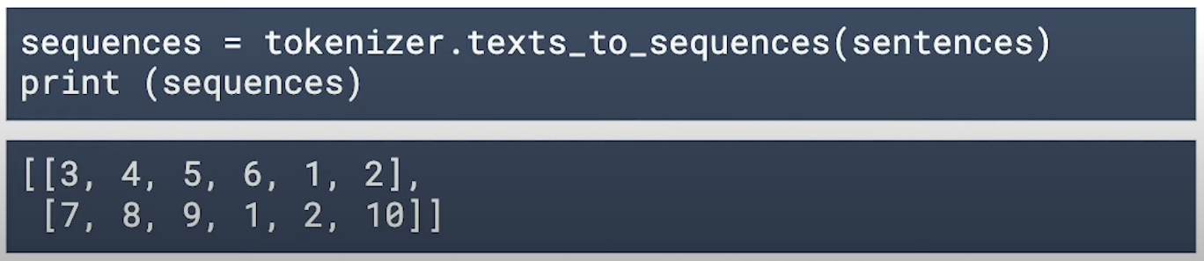
Turn sentences into sequences
Use texts_to_sequences() to turn sentences into sequences
‘My favorite food is ice cream’,
‘do you like ice cream too?,

Slide 21
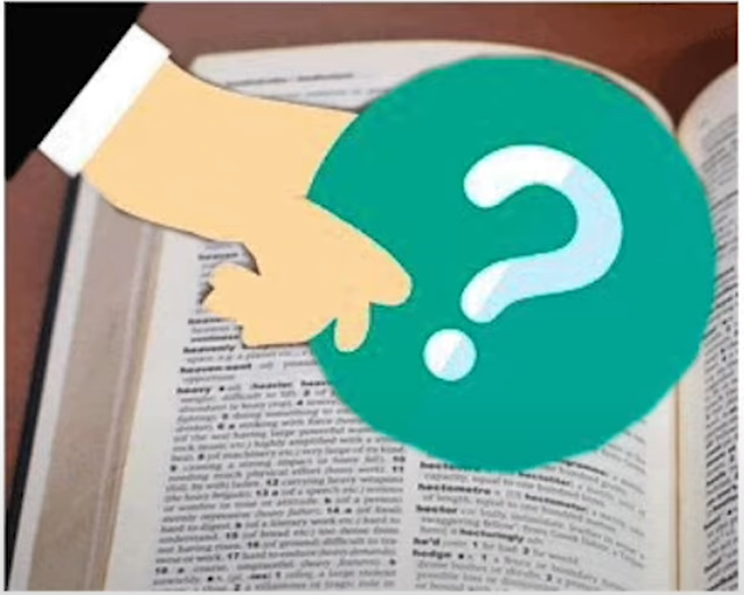
OOV token
Sometimes sentences being sequenced will contain words that are not in the word index.
To handle these situations, you could specify an “Out of vocabulary” or OOV token when you create the tokenizer.

Slide 22
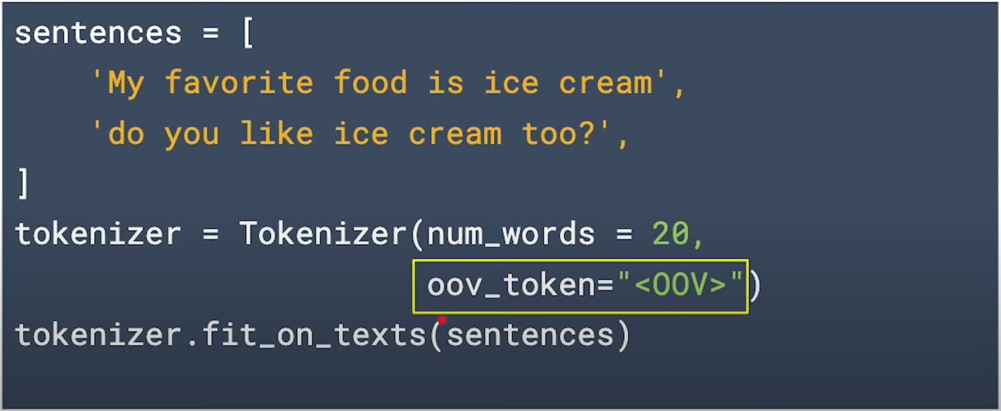
OOV token

Slide 23
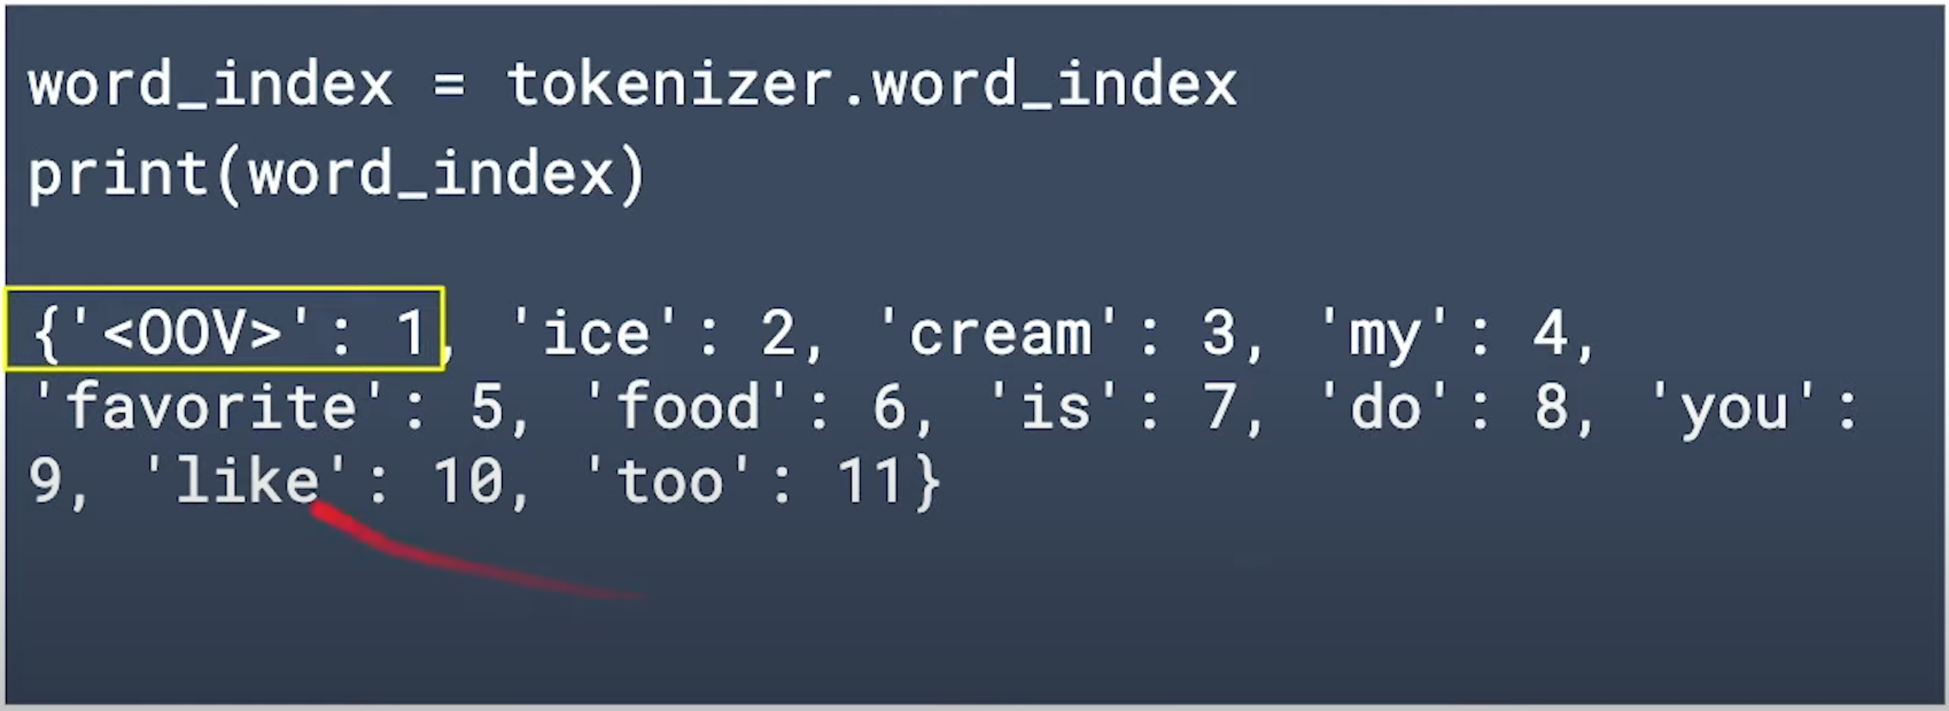
Checking the word index

Slide 24
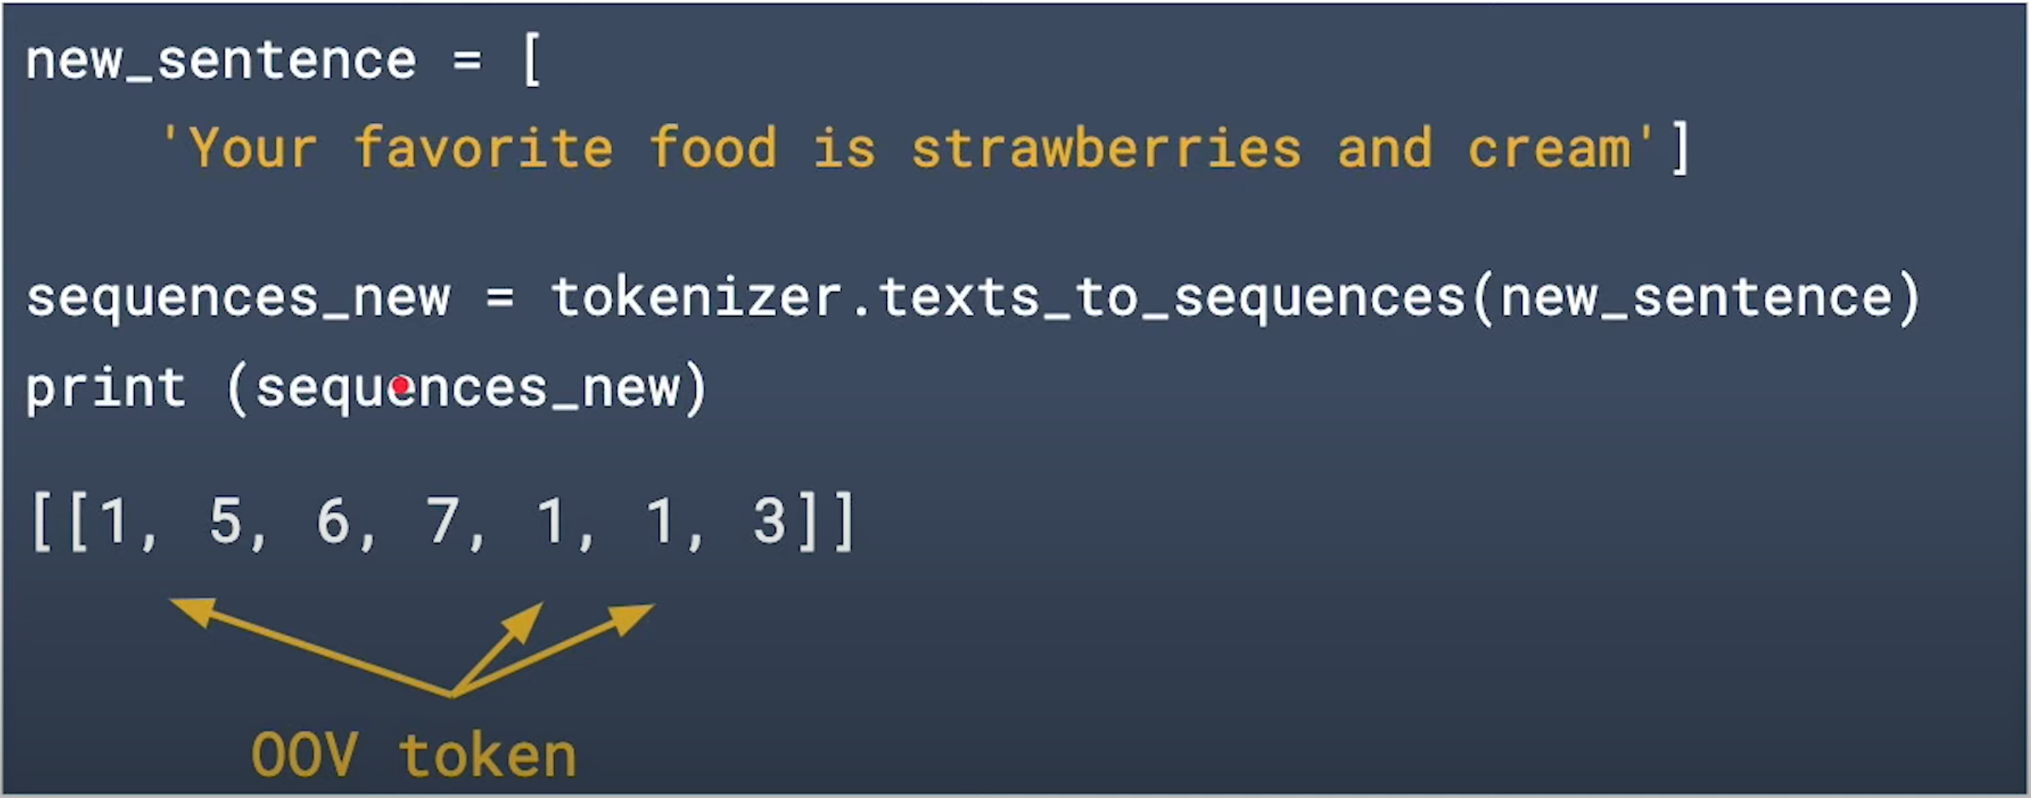
Sequence a new sentence

Slide 25
Why do we need an OOV?
When training a neural network, you train the model with a known dataset and validate and predict with datasets that the model has not seen yet
It is very likely that the validation and prediction text will contain words that are not in the word index.

Slide 26
Preparing data
Tokenize the data
Create sequences for the sentences
Make the sequences have the same length

Slide 27
Pad Sequences
When we are using images as an input to our neural network, we needed to make sure that all of the images are of the same size. The input data must all have the same shape.
It is the same thing with text data, we also need to make sure all the sequences are of the same length. Not every sentence will be the same length!

Slide 28
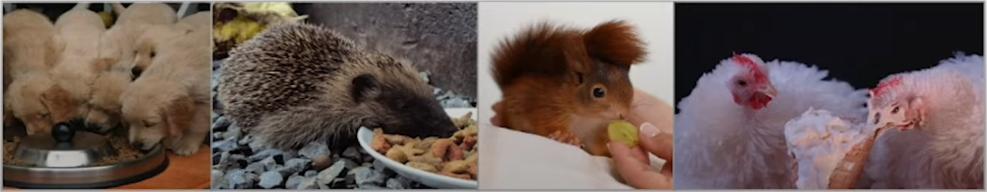
Pad Sequences
I like hot chocolate
My dogs and my hedgehog like kibble but my squirrel prefers grapes and my chickens like ice cream, preferably vanilla

Slide 29
Pad Sequences
I like hot chocolate
[4, 2, 5, 6]
My dogs and my hedgehog like kibble but my squirrel prefers grapes and my chickens like ice cream, preferably vanilla
[1, 7, 3, 1, 8, 2, 9, 10, 1, 11, 12, 13, 3, 1, 14, 2,
15, 16, 17, 18]

Slide 30
Pad Sequences
I like hot chocolate
[4, 2, 5, 6, 0, 0, 0, 0, 0, 0
0, 0, 0, 0, 0, 0, 0, 0, 0, 0]
My dogs and my hedgehog like kibble but my squirrel prefers grapes and my chickens like ice cream, preferably vanilla
[1, 7, 3, 1, 8, 2, 9, 10, 1, 11,
12, 13, 3, 1, 14, 2, 15, 16, 17, 18]

Slide 31
Truncate Sequences
We can also truncate sentences to both have 10 items.
I like hot chocolate
[4, 2, 5, 6, 0, 0, 0, 0, 0, 0]
My dogs and my hedgehog like kibble but my squirrel
[1, 7, 3, 1, 8, 2, 9, 10, 1, 11]

Slide 32
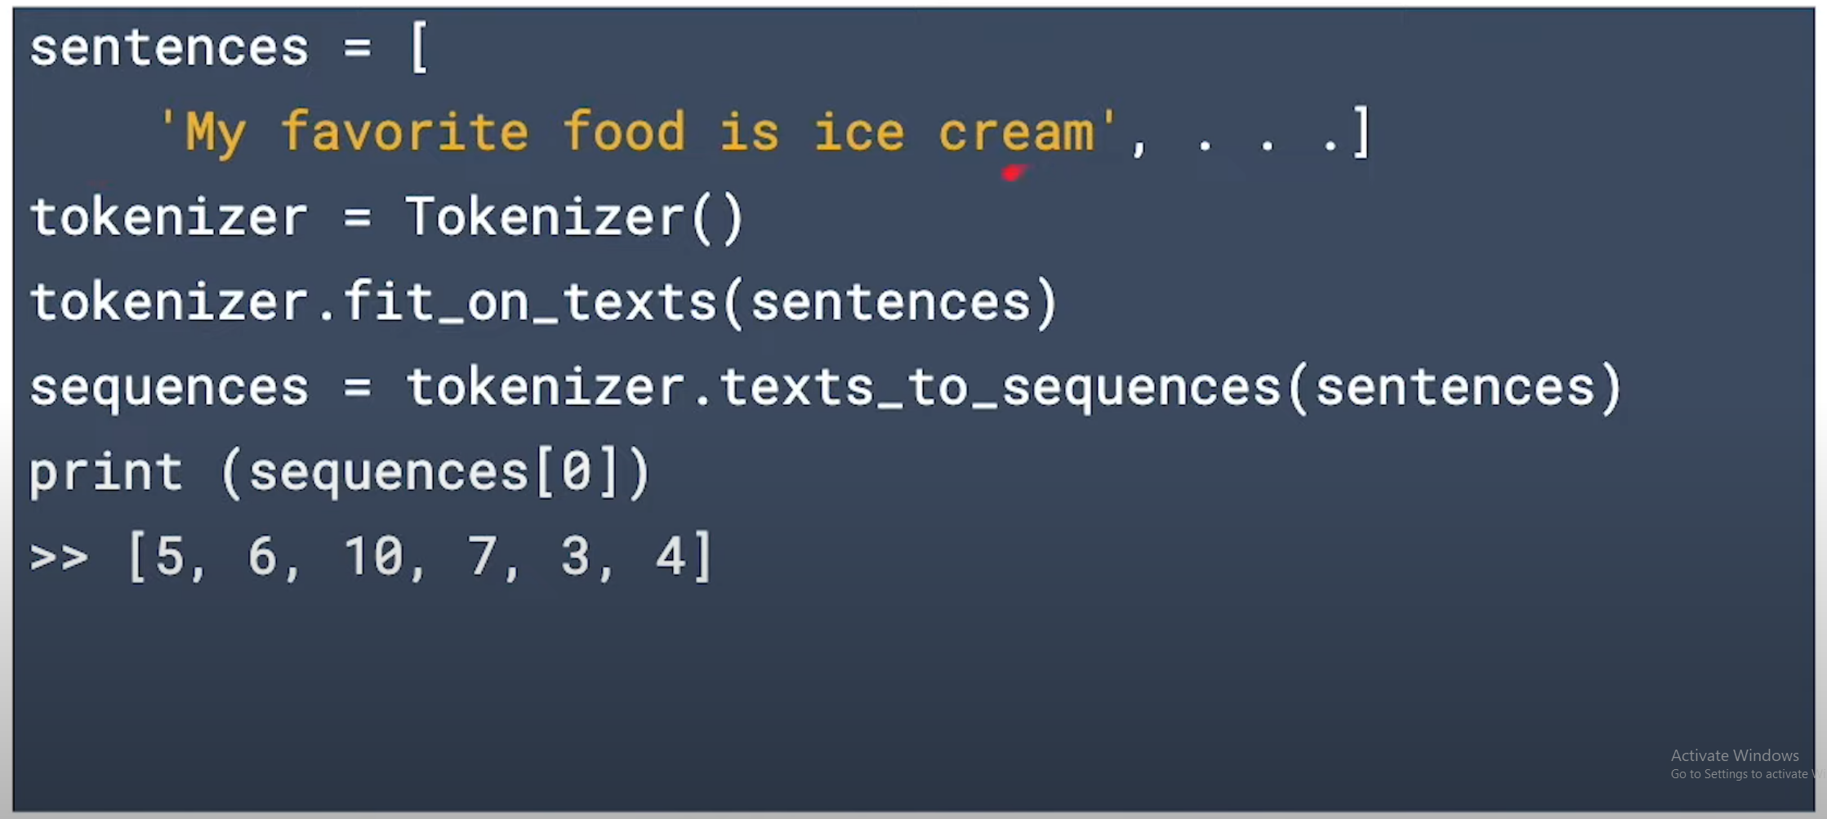
Example

Slide 33
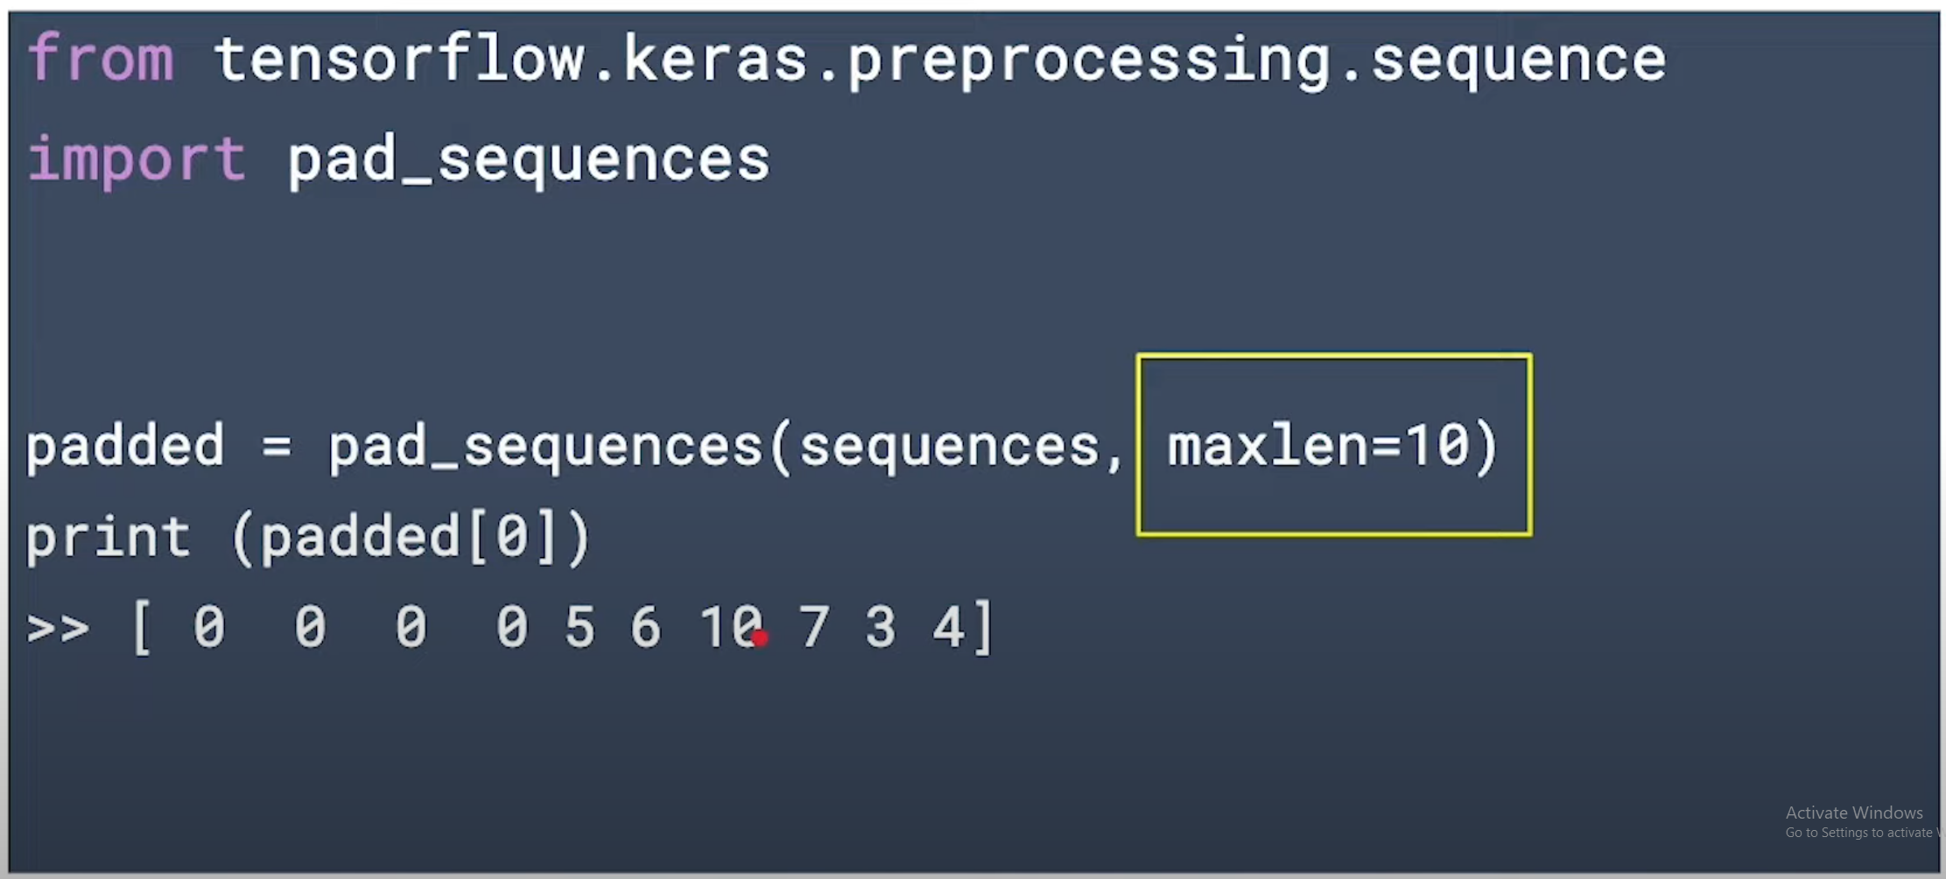
Example

Slide 34
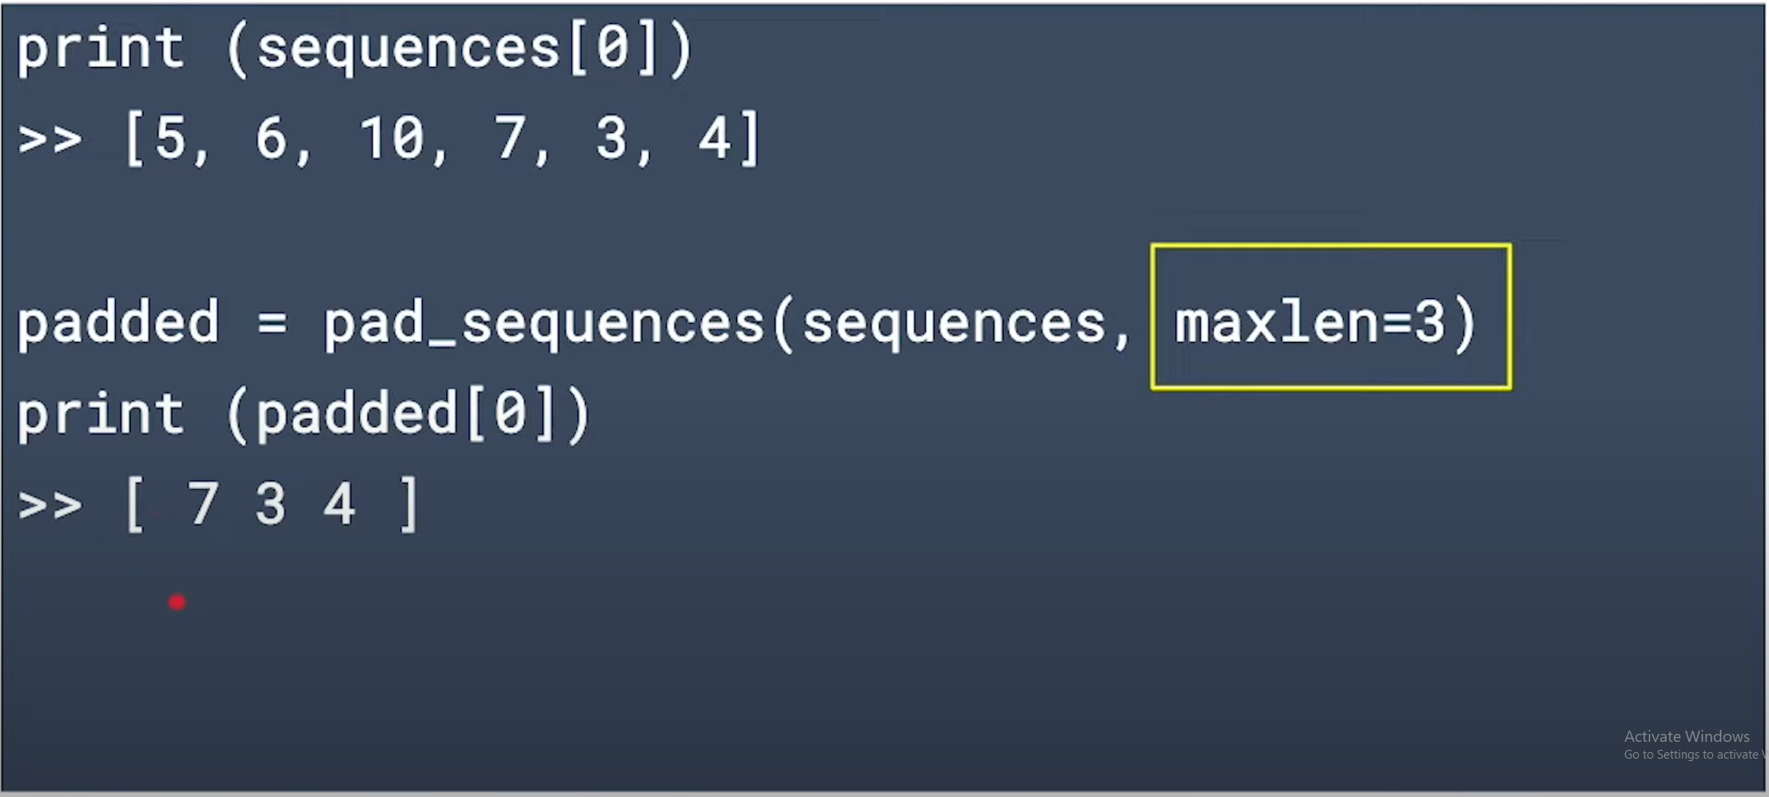
Example

Slide 35
Padding and Truncating Options
By default, pad_sequences pads to the longest sequence
Specify maxlen to set the length of the sequences
By default, sequences are padded or truncated from the start of the sequence
Specify padding=‘post’ to pad from the end of the sequence
Specify truncating=‘post’ to truncate from the end of the sequence

Slide 36
Summary: Prepare the data
Create the tokenizer
tokenizer = Tokenizer(num_words=100,oov_token=“OOV”)
Tokenize the words
tokenizer.fit_on_texts(text_input)
Create sequences for the sentences
tokenizer.text_to_sequences(text_input)
Make the sentences all the same length
pad_sequences(sequences, maxlen=50)

